Slide 1
Python programming
unit 6 – pygame

Slide 2

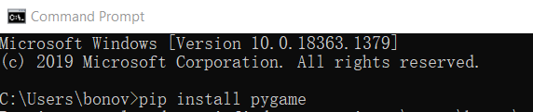
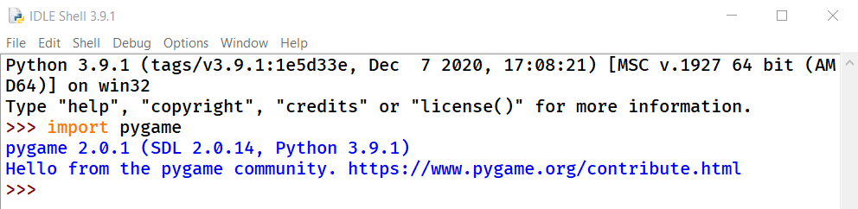
Pygame programming
pygame
It is a third party package to support python programming. Use pip install pygame to install this package.
Under python idle shell prompt, or cmd python prompt, use import pygame to verify it is correctly installed.

Slide 3
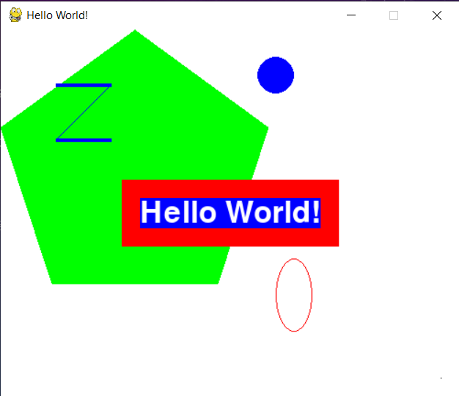
First graphic program using pygame
Pygame is a package that can help to use graphic programming, especially good for games.
We create our first pygame program to do the following:
Draw on screen polygon, circle, line
Show text on screen
Able to close the program window
Learn the basic framework to do a program based on pygame

Slide 4
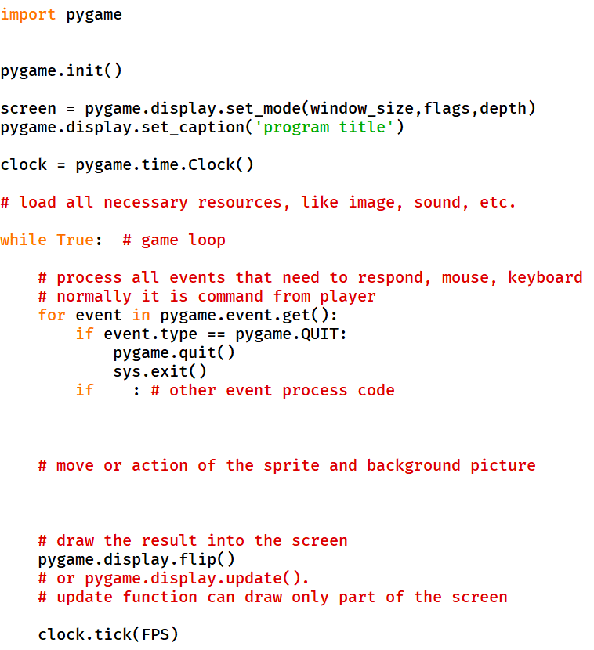
Basic pygame program frame

Slide 5
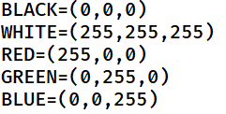
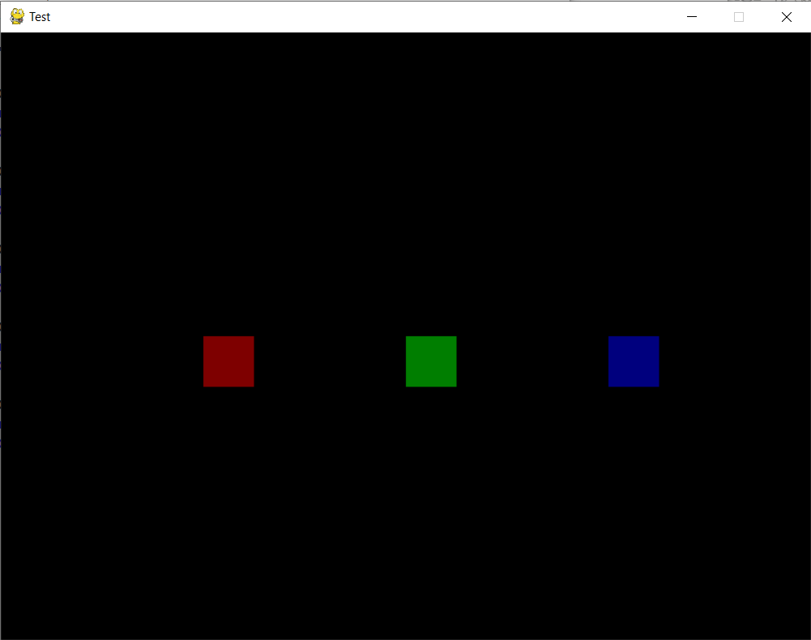
Color in pygame
In pygame, colors are using a system call RGB color to describe.
3 integers tuple, each value from 0~255, to represent how much RED, GREEN, and BLUE respectively
pygame.color.THECOLORS, has a list of name and color tuple. We can use all those color names as color in pygame programming.
There is a 4th value called Alpha, which determines how much transparency:
Alpha value also 0~255. value 0 means completely transparent, and 255 means completely no transparency.
Cyan | (0,255,255)
Yellow | (255,255,0)
Fuchsia | (255,0,255)
Purple | (128,0,128)
Gray | (128,128,128)
Silver | (192,192,192)
Pink | (255,192,203)
Brown | (165,42,42)
Orange | (255,165,0)

Slide 6
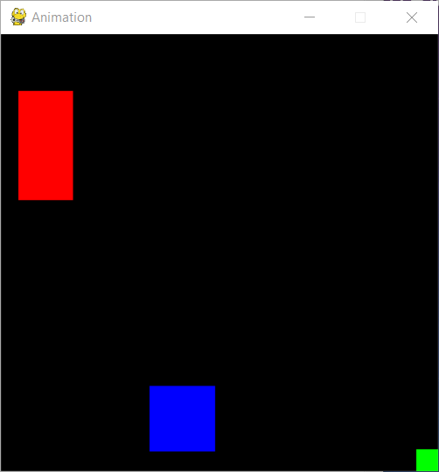
Animation: how to make movement
In pygame, the movement is achieved using a series of picture shown, it is called frames. How many frames shown each second, is call the frame rate (FPS).
Each round of the game loop, program draw a picture on screen.
A moving rectangle program:
Each round of the game loop, draw rectangle with a small location different to last loop.
When reach edge bounce back.

Slide 7
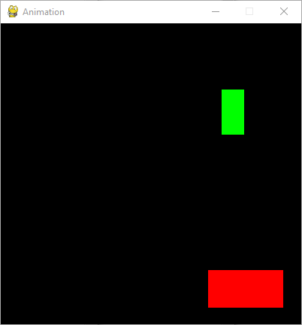
collision: how to interact
2 rectangle bounce each other:
Detect the collision. Decide which side collide.
Decide the way of bounce each other.

Slide 8
Collision: how to detect collision details between 2 blocks
Functions can help to do collision detection:
Rect collide with point (collidepoint())
Rect collide with another rect (colliderect())
Rect crops another rect (clip())
Rect crop a line inside (clipline())
How to differentiate collision detail? E.g., side collision, corner collision.
If those are round objects, how to decide collision point and decide bounce angle?
According to physics, if assume mass is same, the speed perpendicular to collision side, will be changed. The speed along the collision side will remain same.
The speed vertical to collision side change: V2(after) = V1(before), V1(after) = V2(before). Map this to the change of X.Y. axis speeds and X.Y. axis speed directions.

Slide 9
Event detailed
Pygame support player using many device to control the game sprite to move and perform certain action. The normal device we use when playing on computer is keyboard and mouse.
The event that related to keyboard and mouse are: key pressed down, key released, mouse button pressed, mouse button released, mouse movement.
Change the moving rectangle program:
Allow player use keyboard to control the movement of the big rectangle.
Mouse click will create some secret rectangles and it can also be eaten.

Slide 10
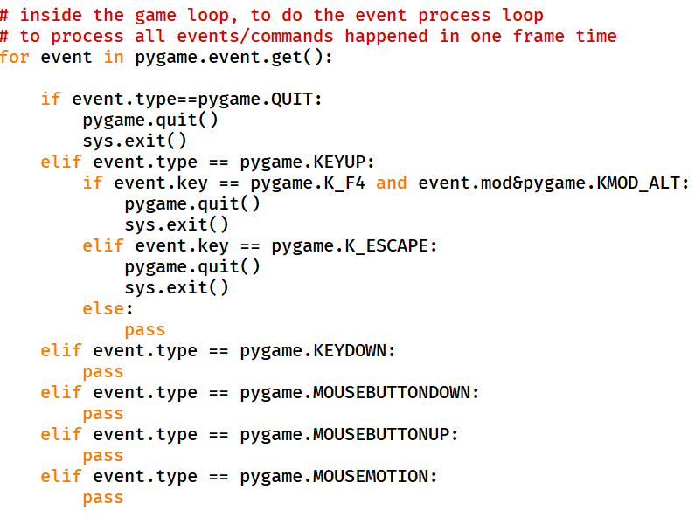
Event detailed
Event Type | Parameters
QUIT | None
ACTIVEEVENT | gain, state
KEYDOWN | unicode, key, mod
KEYUP | key, mod
MOUSEMOTION | pos, rel, buttons
MOUSEBUTTONUP | pos, button
MOUSEBUTTONDOWN | pos, button
TEXTINPUT | Text
MOUSEWHEEL

Slide 11
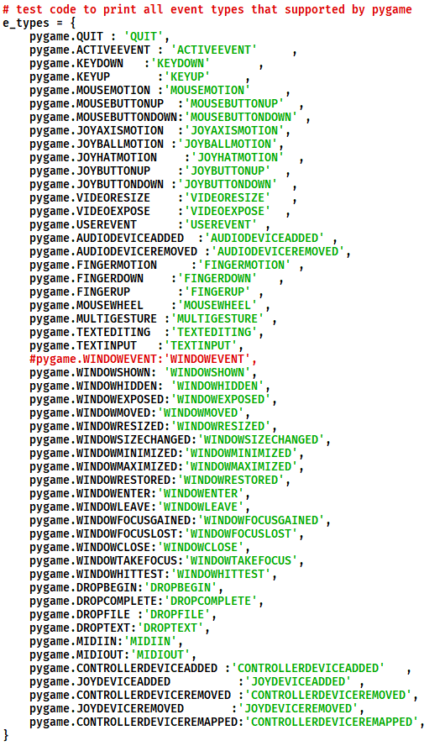
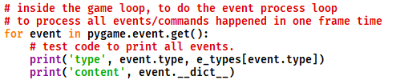
Watch all the pygame Events
Before QUIT, there always a WINDOWCLOSE event.
“Alt + F4” key combination DOWN and UP event cannot detect. The actual event is WINDOWCLOSE and QUIT.

Slide 12
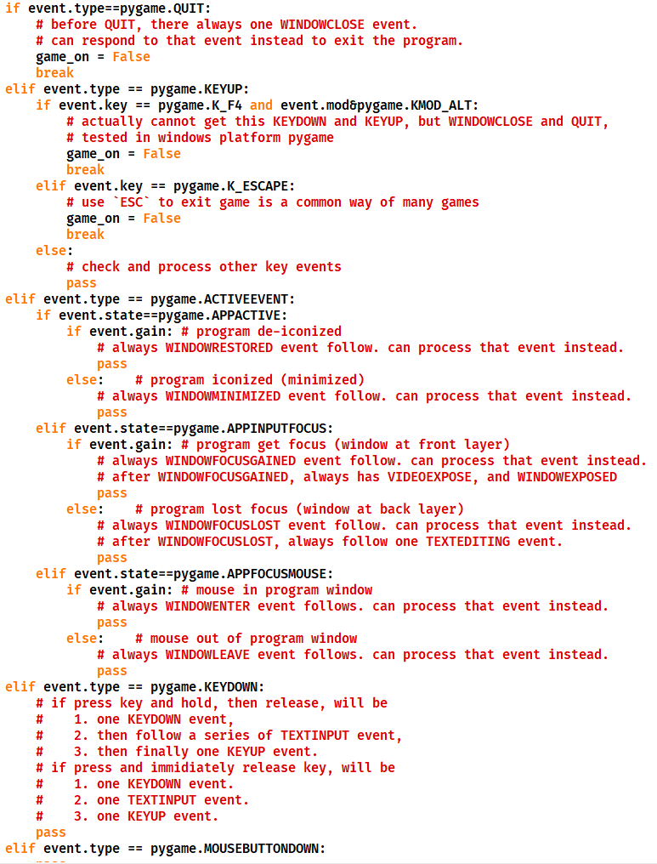
Event detailed: main event processing logic

Slide 13
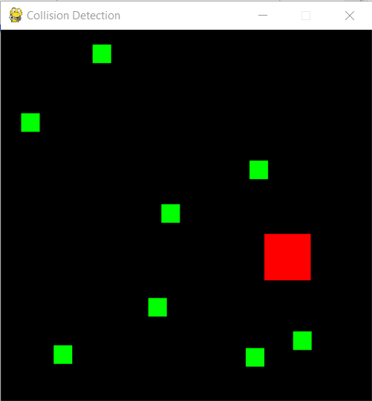
Control and collision together
Design a kind of game, the big block under control to move.
When it collide with small block, it will eat it and grow to bigger size.
Small block which was eaten, will disappear.
Game will regenerate one small block after certain time, if total is less than 10
Addition: add mouse click respond, make a new small block with different color in the place mouse clicked.

Slide 14
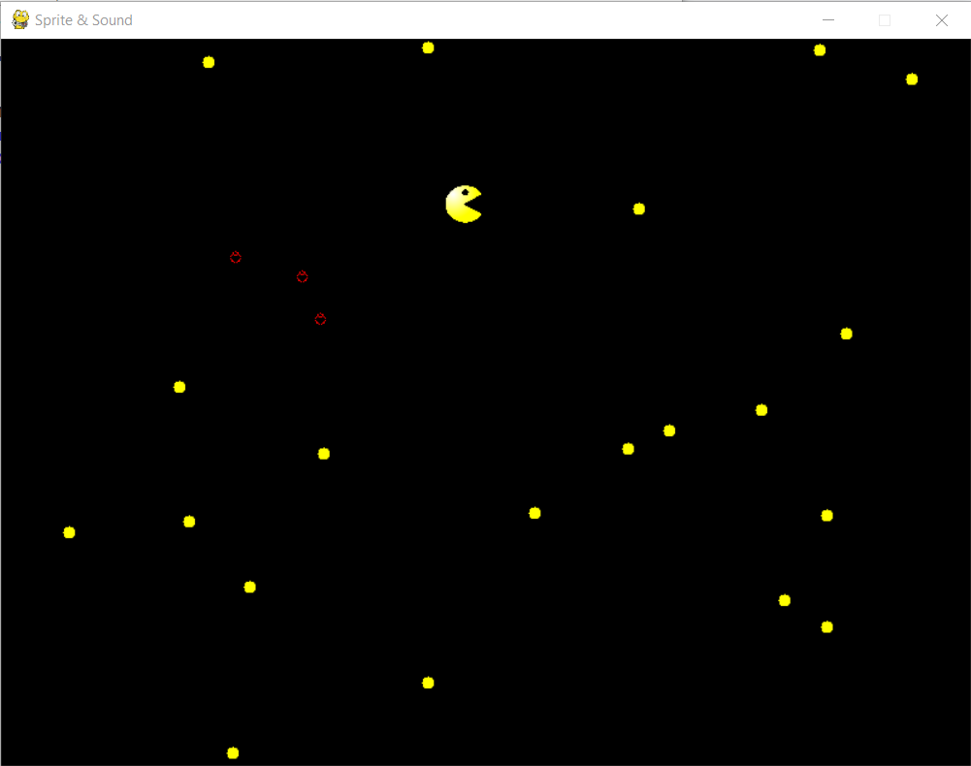
Add sprite image and sound to game
Change the rectangle eat program to PAC-MAN eat program
Replace large rectangle with pac-man picture.
Replace small rectangles with yellow dots
Change mouse click to add special type: ghost.
When eat yellow dots, pac-man increase size.
When eat ghost, pac-man reduce size.
Add background music when playing.
Add sound effect when pac-man eating one dot.

Slide 15
Add sprite and sound to game
Change the rectangle eat program to PAC-MAN eat program
Replace large rectangle with pac-man picture.
Replace small rectangles with yellow dots
Make the program able to add special type: ghost. Use mouse button click to add it on screen
When eat yellow dots, pac-man increase size.
When eat ghost, pac-man reduce size.
Add background music when playing.
Add sound effect when pac-man eating one dot.

Slide 16
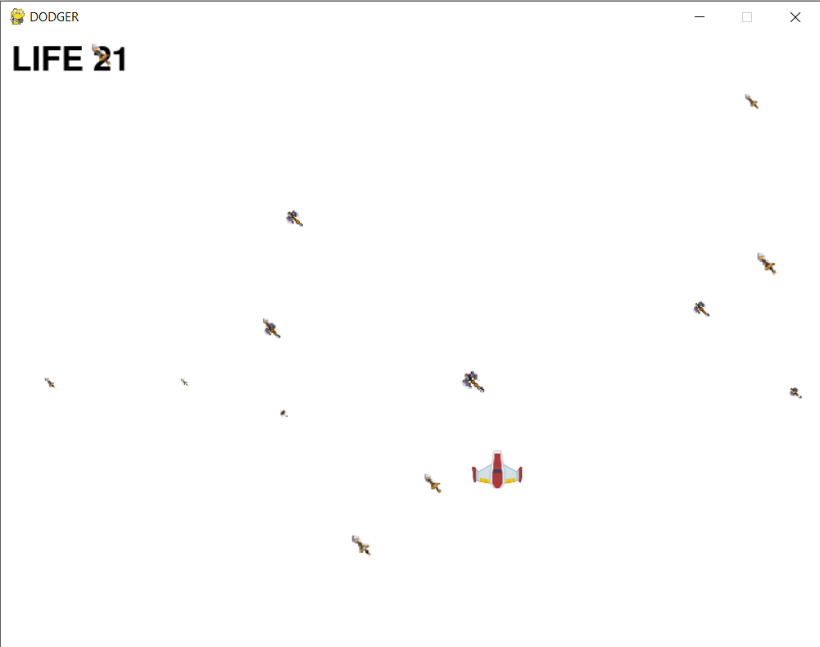
Dodger game
A flying aircraft dodge the attacking weapons
Weapons drop from top to bottom.
Weapons dodge the weapons. When hit by weapon it’s life reduce.
When life reaches 0 game over.

Slide 17
Sprite rotate technique
Pygame rotate function
Simply use pygame.transform.rotate(), maybe the result is not your wanted. The sprite maybe not looks like rotating. The reason is the centering of rotation. Pygame function do not have a way to keep the center position.
If want to make the sprite rotate around one specific center, need to customize programming.

Slide 18
OOP with pygame
Sprite class and sprite Group
Inherit from the Sprite class, or DirtySprite class, make your own sprite of your game.
Customize the update() method of your sprite to make it move in each frame time.
Arrange your sprites in Group. Call group.draw() method to blit the sprite onto your screen.
Arrange the pygame.display.update(), can pass the rect area list to it to only update part of the screen.

Slide 19
OOP with pygame
1st common way
Inherit from Sprite class, and use RenderUpdates group
The group draw will return the rect list which needs to update to screen. Can be used as parameter to update()
2nd common way
Inherit from DirtySprite, and use LayeredDirty group
For those static sprites, which can set dirty to 0, then draw will not involve them.

